Slide 1
Deep Convolutional Neural Network for Inverse Problems in Imaging
Prepared by :
Nikhitha 1602-17-737-087
Sritej 1602-17-737-108

Slide 2
Cracking the title
Inverse problems
Ill posed
Convolutional neural network
Deep Convolutional neural network

Slide 3




Convolutional neural network
How did you recognize?

Slide 4
Evolution of inverse problems
X-ray
Backward projection
Filtered backward projection
Filtered backward projection + Regularisation
Filtered backward projection + Covolutional neural networks
X-ray

Slide 5
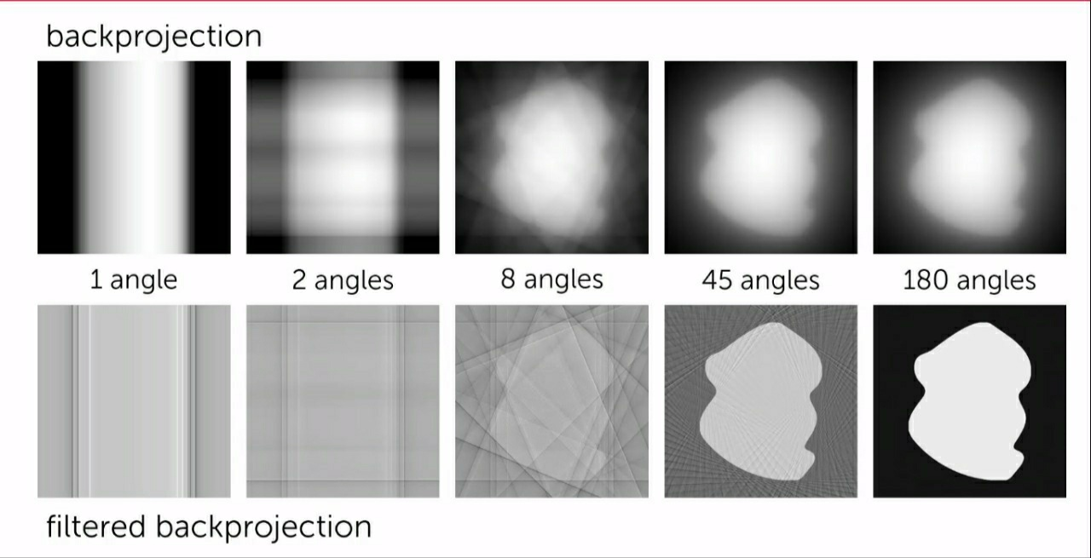
X-ray

Slide 6
Contd ….
Filtered backward projection + Regularisation Removes noise Iterative approach | Filtered backward projection + Covolutional neural networks Removes noise Self learning model

Slide 7
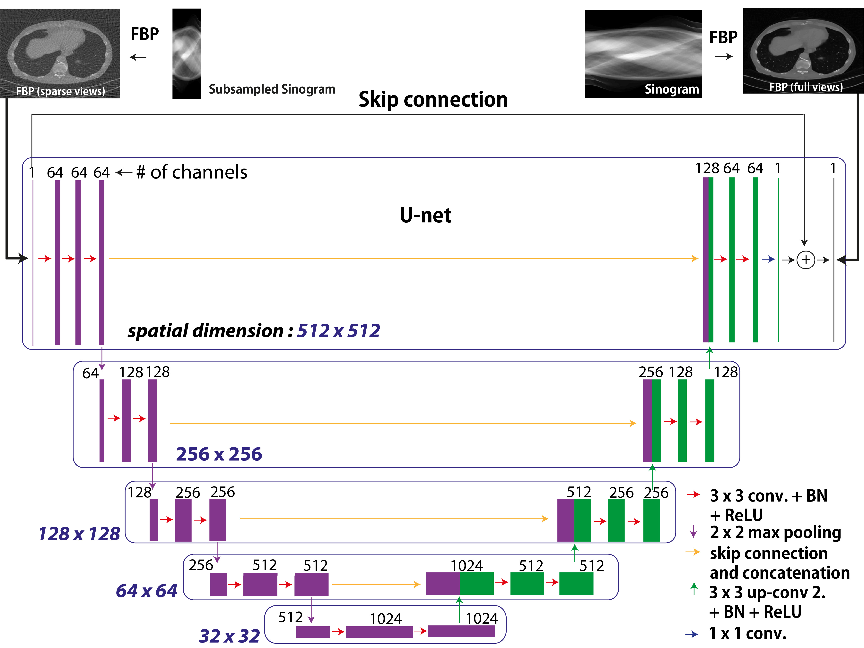
U – architecture

Slide 8
Drawbacks of using regularisation
Computation complexity
Hyper parameter selection
Data sets
Ellipsoid
Bio medical
Experimental

Slide 9
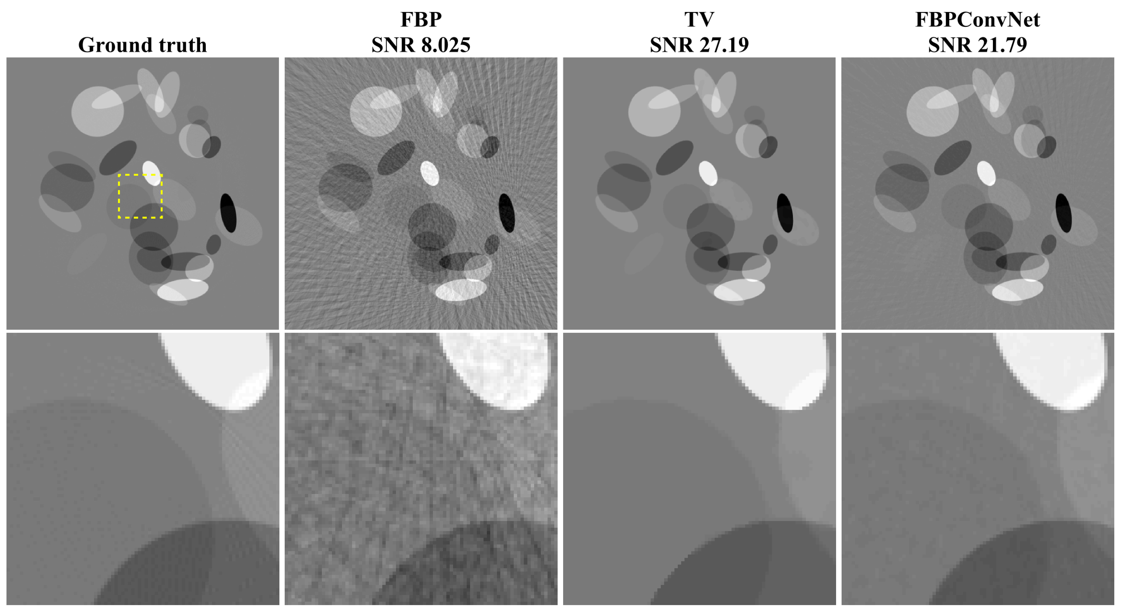
Ellipsoid data set

Slide 10
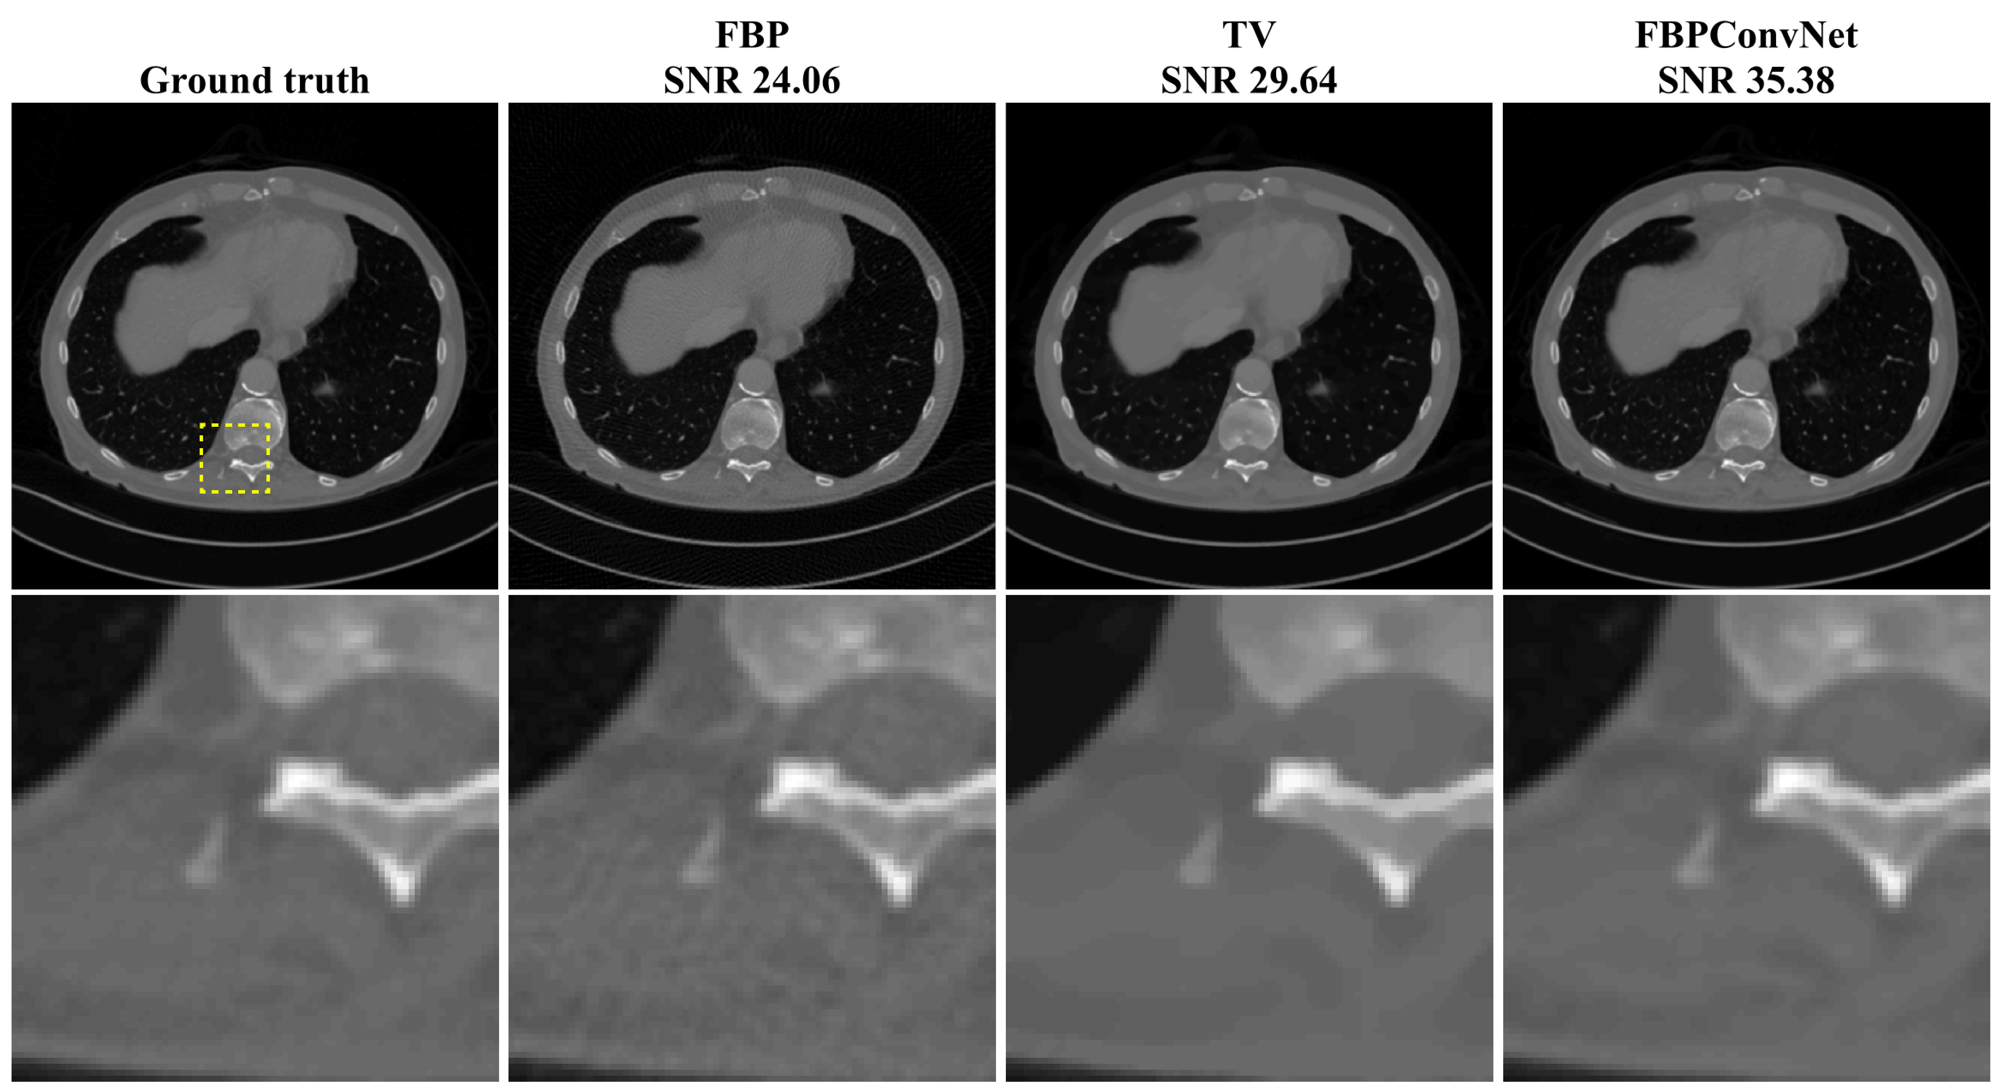
Bio medical data set

Slide 11
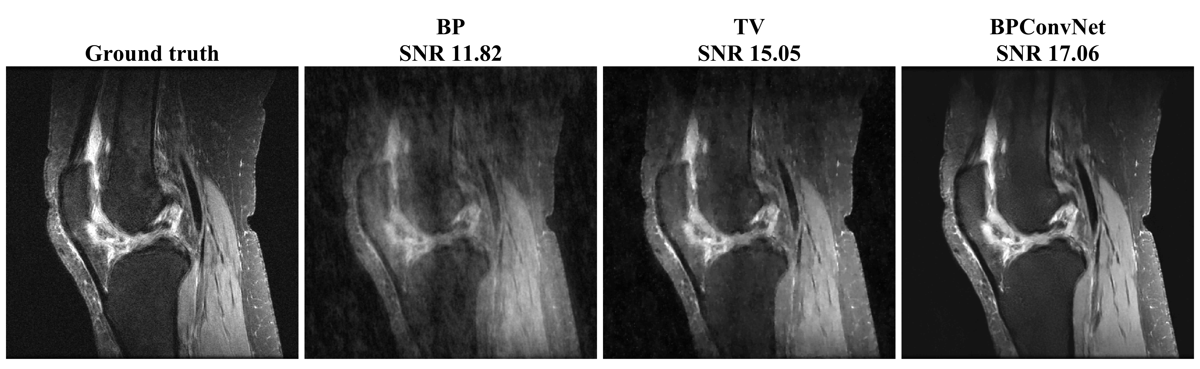
Experimental data set

Slide 12
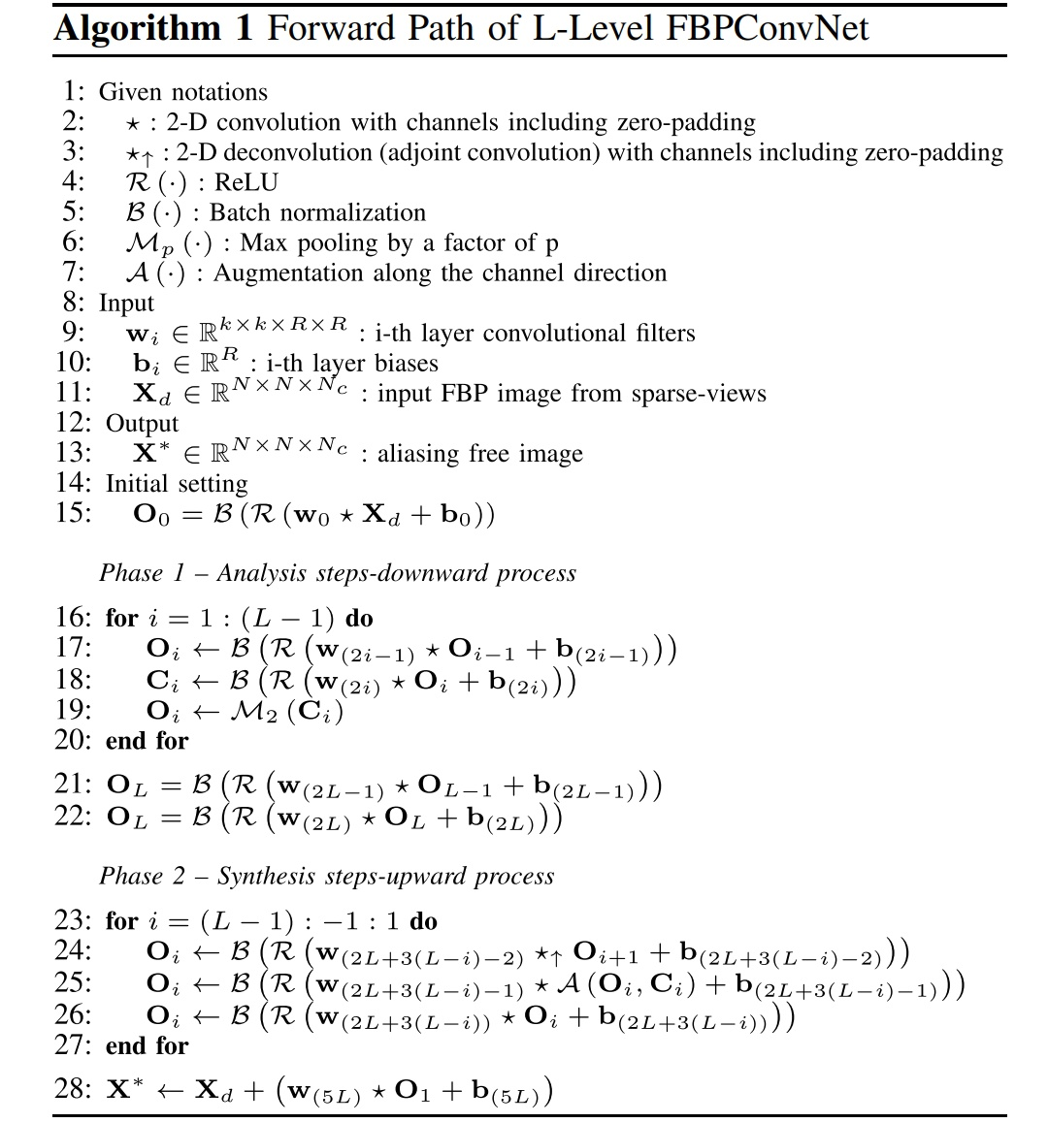

Slide 13
Future scope
Solve all inverse problems
Transfer over data sets

Slide 14
References
1] L. I. Rudin, S. Osher, and E. Fatemi, “Nonlinear total variation based noise removal algorithms,” Phys. D, Nonlinear Phenomena, vol. 60, nos. 1–4, pp. 259–268, 1992.
[2] A. Chambolle, “An algorithm for total variation minimization and applications,” J. Math. Imag. Vis., vol. 20, no. 1, pp. 89–97, 2004.
[3] S. G. Chang, B. Yu, and M. Vetterli, “Adaptive wavelet thresholding for image denoising and compression,” IEEE Trans. Image Process., vol. 9, no. 9, pp. 1532–1546, Sep. 2000.
[4] T. F. Chan and C.-K. Wong, “Total variation blind deconvolution,” IEEE Trans. Image Process., vol. 7, no. 3, pp. 370–375, Mar. 1998.

